Slide 1
The Battle of the Neighborhoods: Toronto

Slide 2
BACKGROUND
Toronto is the capital city of the Canadian province of Ontario. It is the most populous city in Canada with a population of over 2.9 million. Toronto is an international center of business, finance, arts, and culture. The city has a high concentration of banks and brokerage firms and is considered the financial and industrial capital of Canada. The city is also recognized as one of the most multicultural and cosmopolitan cities in the world.

Slide 3
PROBLEM
A client is looking to open a sushi restaurant in Toronto. Sushi menus tend to be expensive, however, sushi lovers are willing to pay a premium price for an expertly crafted roll. Sushi thrives in urban centers with an active nightlife and in an area with a concentration of working professionals. A sushi restaurant that is located within a walking distance of office workers can bring a booming business during the day. If the restaurant is also located near a thriving bar, it can bring customers in for dinner.

Slide 4
DATA ACUISITION AND CLEANING
The postal codes of Toronto was scraped from wikipedia.org
Geographical coordinates of each postal codes were downloaded from the csv file Geospatial_data.csv.
Average real estate prices of each postal codes in Toronto was scraped from housepricehub.com
Duplicate and missing values were dropped.

Slide 5
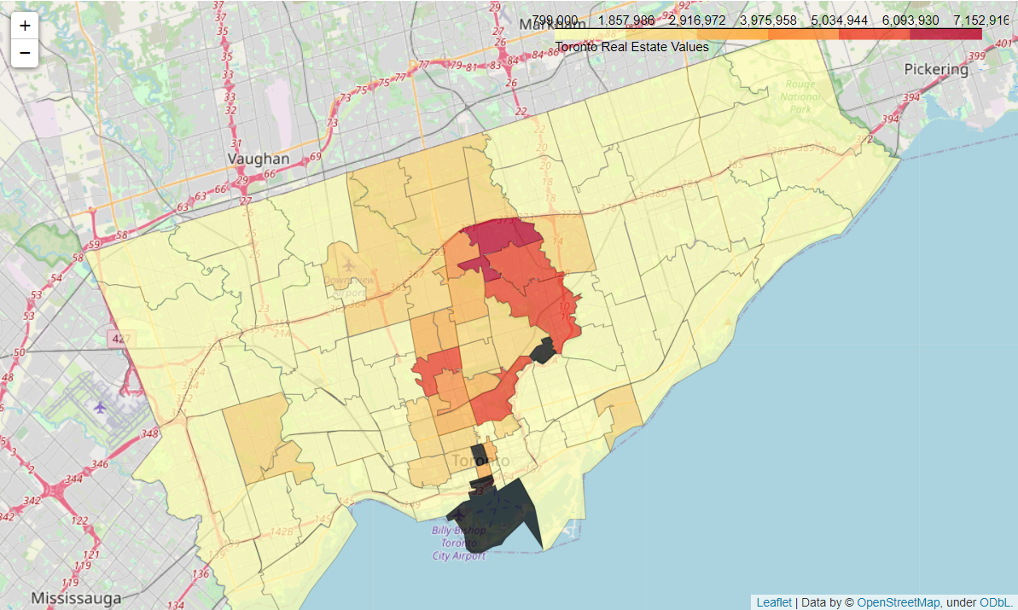
TORONTO REAL ESTATE VALUES

Slide 6
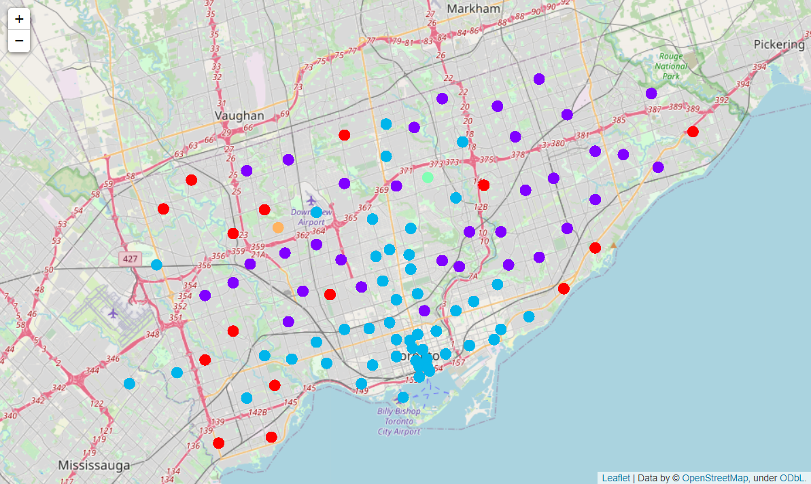
TORONTO NEIGHBORHOOD CLUSTERS
Cluster 1 includes mostly parks, pharmacies, gyms, shopping malls, etc. These locations are near residential areas.
Cluster 2 is similar to Cluster 1 but also includes several Portuguese restaurants.
Cluster 3 makes up the majority of the neighborhoods. These are mostly business areas with coffee shops, pizza places, restaurants, bars, etc. There are also many social activity venues.

Slide 7
CONCLUSION
By analyzing the venues in Toronto using Foursquare, locations that have many venues and don't already have a sushi restaurant have been identified.
Based on the findings, neighborhoods in Cluster 3 will be ideal locations for the sushi restaurant.
The neighborhoods in Cluster 3 that I believe are optimal for opening a sushi restaurant are 1) Don Mills North; 2) Kensington, Chinatown, Grange Park; and 3) The Annex, North Midtown, Yorkville.
According to the real estate data gathered, these locations have higher than average real estate prices which indicates that these neighborhoods are optimal for a sushi restaurant.
Final decision on optimal restaurant location will be made by my client taking into consideration additional factors such as attractiveness of each location, real estate availability, prices, social and economic dynamics, etc.

